Slide 1
Web Scraping Project
Derek Li

Slide 2
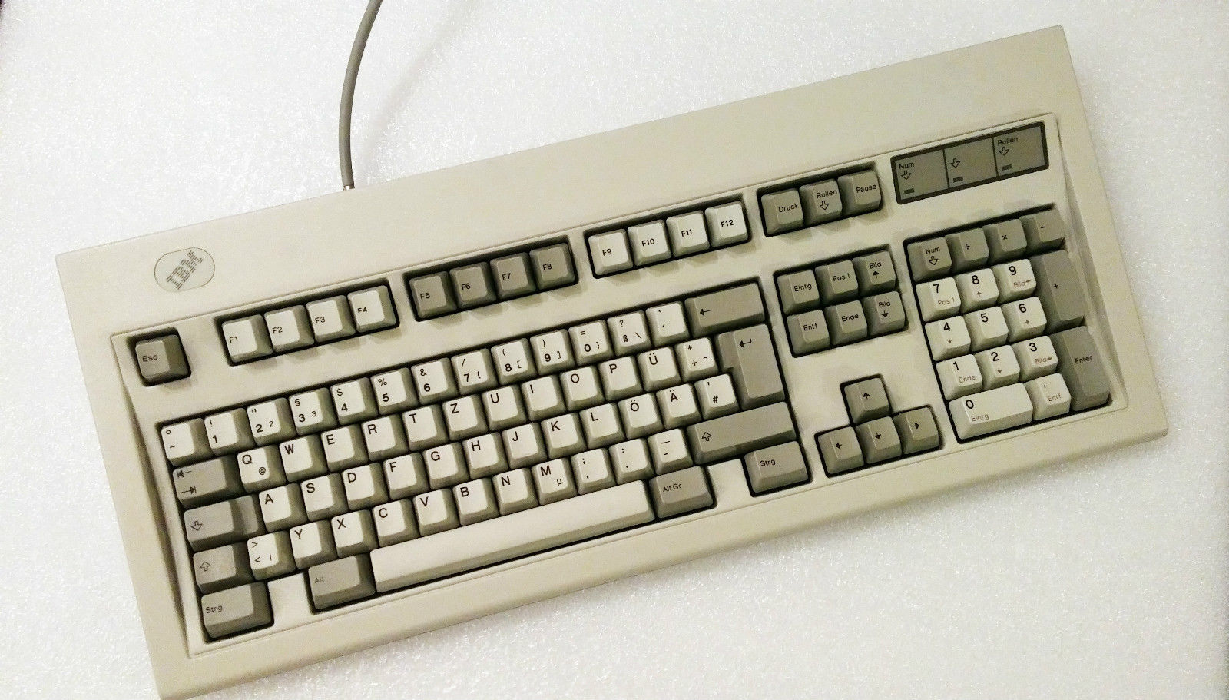
https://geekhack.org/index.php?topic=86607.0

Slide 3
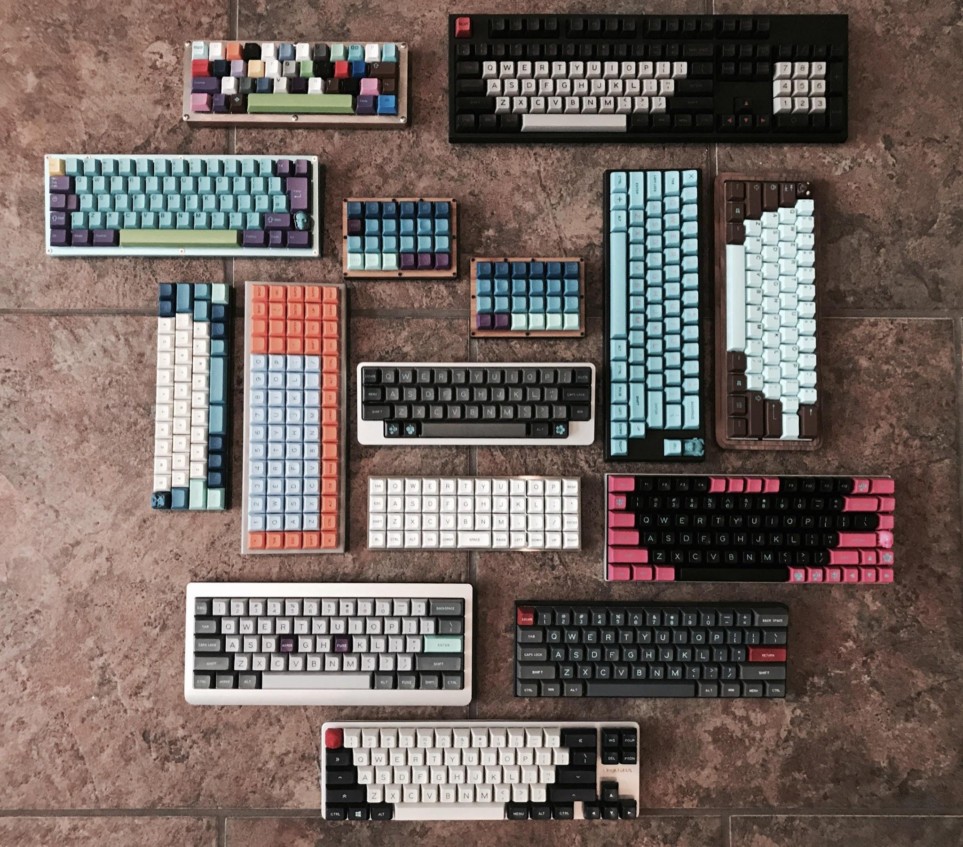
https://www.reddit.com/r/MechanicalKeyboards/comments/75qffu/f_a_m_i_l_y_album_and_details_in_comments/

Slide 4
I should warn you...

Slide 5

https://www.reddit.com/r/MechanicalKeyboards/comments/9rkru0/when_someone_you_know_gets_into_the_hobby/

Slide 6

BEEEEP
https://www.reddit.com/r/MechanicalKeyboards/comments/8cx9wl/me_irl/

Slide 7
Pre-Build Mechanical Keyboards

Slide 8
mechanicalkeyboards.com

Slide 9
797 observations, 20 variables

Slide 10
Brands

Slide 11
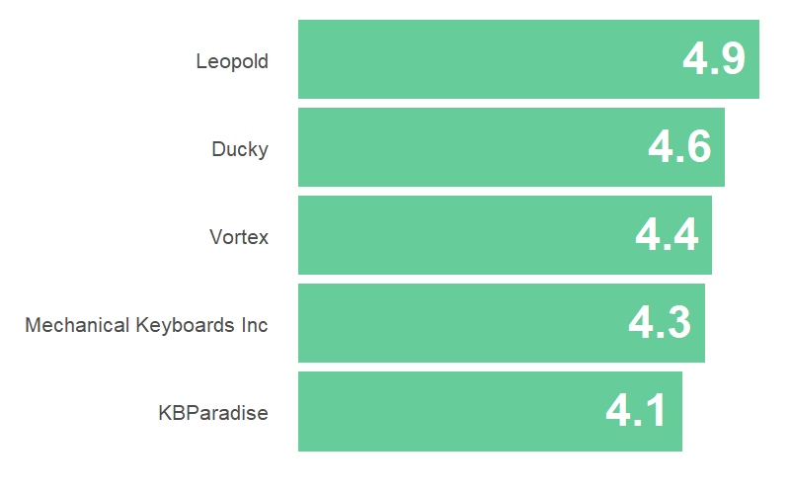

Slide 12
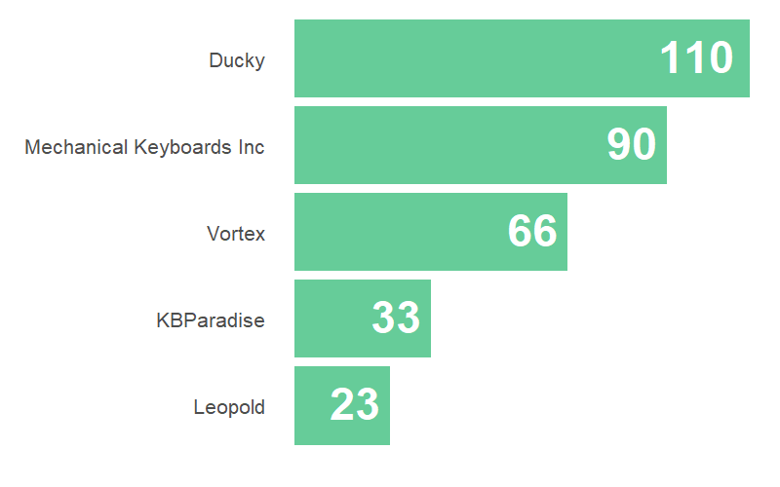

Slide 13
Mechanical Switches

Slide 14
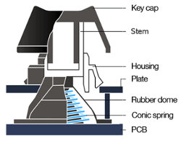
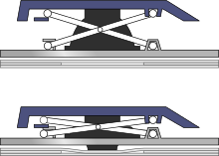
Membrane
Mechanical
Cherry
Topre
http://xahlee.info/kbd/keyboard_switch_mechanisms.html
https://steelseries.com/blog/gaming-keyboard-mechanical-switches-44
https://www.keyboardco.com/support.asp

Slide 15
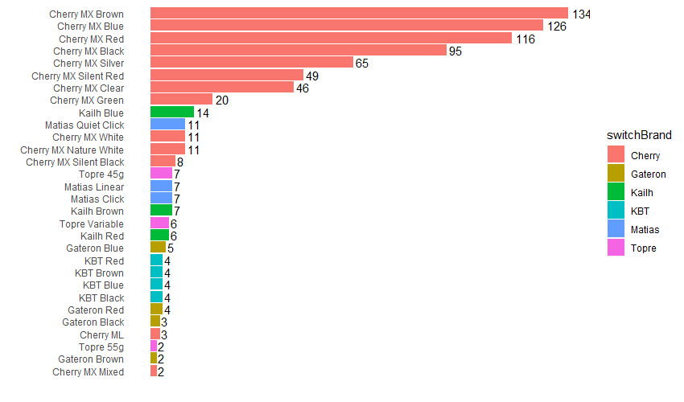

Slide 16
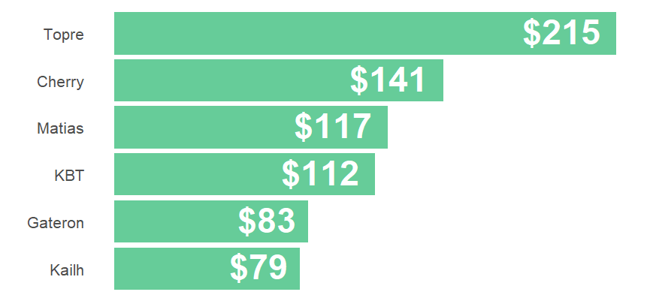

Slide 17
Back Lighting

Slide 18
https://www.gamecrate.com/reviews/review-patriot-viper-v760-rgb-gaming-keyboard/12530

Slide 19
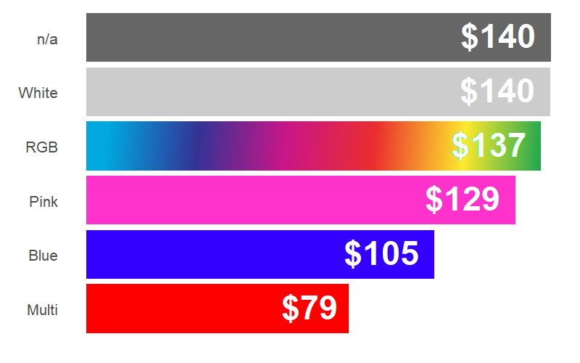

Slide 20
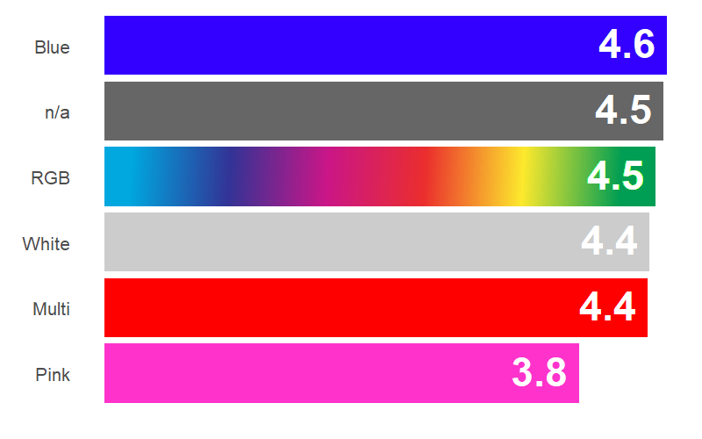

Slide 21
Still too much information...

Slide 22
So I built a thing...

Slide 23
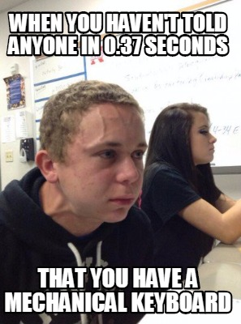
Future Works
Make a recommendation system using item-item based algorithm;
Some NLP analysis on the reviews (although sample size is small);
Work on data from Reddit. Significantly less organized data, but more potential in applying machine learning tools and techniques;
Browse less r/mk...

Slide 24
Thank you!

